Slide 1
Quality Center 9.2
Day-2
Kiran Sarpella

Slide 2
Topics Covered
Quality Center Introduction
Understanding the Quality Center Interface
Understanding Releases Module of Quality Center
Understanding Requirement Module Of Quality Center
Understanding the Business Components Module of Quality Center
Understanding the Test Plan Module of Quality Center
Understanding the Test Lab Module of Quality Center
Understanding the Defects Module of Quality Center
Generating Reports
Generating Graphs

Slide 3
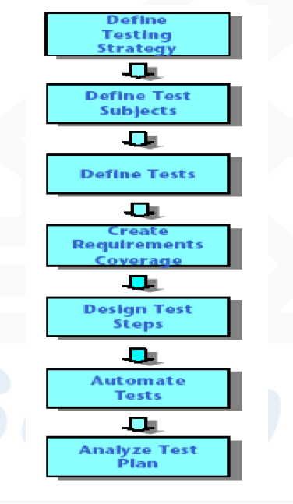
Planning Tests
(Test Plan Module)

Slide 4
Defining Test Subjects
Consider the hierarchical relationship of functions in your application. Divide the functions into subjects and build a test plan tree representing your applications functionality

Slide 5
Planning Tests
Plan the tests for each subject in your test plan tree. Decide which type of tests to create for each subject. then create the tests and assign them to each branch of test plan tree

Slide 6
Creating requirements coverage
Link each test in the test plan tree with a requirements in the requirements tree. By defining the requirements coverage for a test you can keep track of the relationship between the tests in your test plan and your original testing requirements

Slide 7
Designing Test Steps
Design the Tests in your test plan tree. Create test steps describing the operations to perform and the expected results. After you design the test steps decide whether to perform the test manually or to automate it

Slide 8
Automating Tests
After designing test steps decide which steps to automate.
For Automated tests you can design test steps and automate them by generating a test script. The test script can be for winrunner, QTP, Load runner or Visual API-XP.

Slide 9
Analyzing Test plan
Review Test Plan to determine how well it meets the goals that were defined at the beginning of Testing process. Analyze Test plan by generating reports and Graphs.

Slide 10
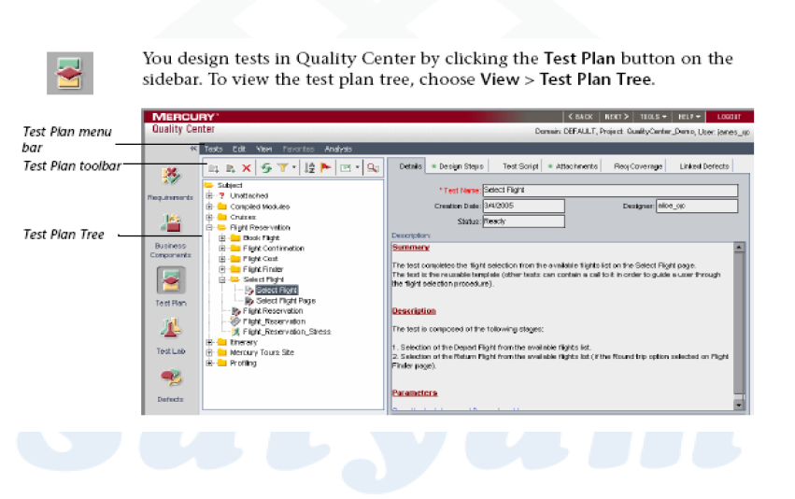
The Test Plan Tree

Slide 11
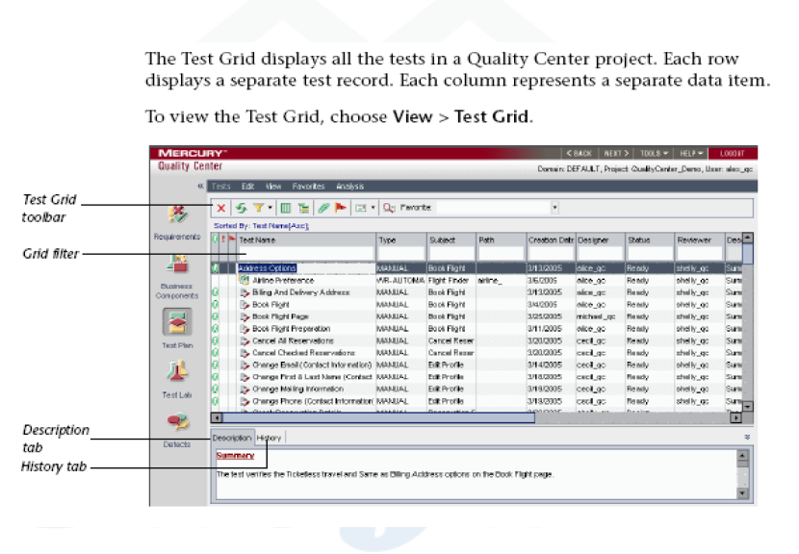
The Test Grid

Slide 12
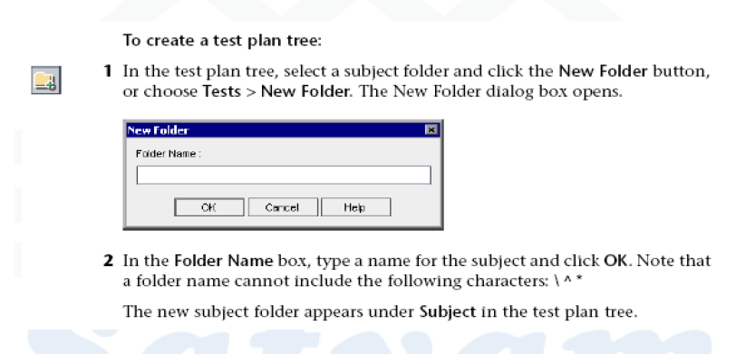
Creating Test Plan Tree

Slide 13
Creating Test Plan Tree
3.In the Description tab, type the description of the folder.
4.Click Attachments tab to add an attachment to the new folder if necessary.
5. Repeat above steps to create additional folders and subfolders.

Slide 14
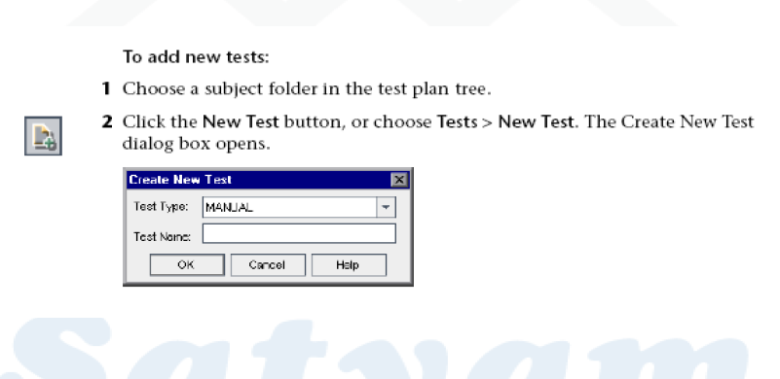
Adding Tests to Test Plan tree

Slide 15
Creating Test Plan Tree
3.Select the test type from the type list.
4.In the Name box enter the Test Name.
5.Click ok on the dialog box.
6.Enter the test details in the Details tab.
7.Click on Attachments tab to add attachments to the folder.

Slide 16
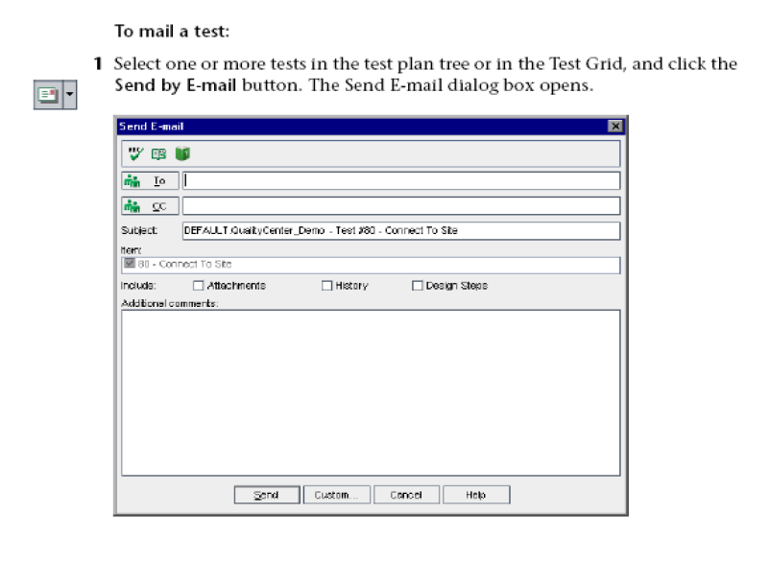
Mailing Tests

Slide 17
Mailing Tests
2.Type a valid e-mail address or click the to button or cc button to select users.
3.Enter the subject of email.
4.Choose if you want to include attachments, history and/or design steps.
5.Spell check and send the mail.

Slide 18
Creating and Viewing Requirements Coverage
In this section we will look into the following things
•Linking Requirements to test
•Linking Tests to a Requirement
•Analyzing Test Coverage

Slide 19
Linking Requirements to a Test
Navigate to the Test Plan page
In the Tree view select the Test for which a requirement is to be linked.
Navigate to the Req coverage tab for the selected test
Click on the Select Req button.
In the requirements tree displayed on the right side of the window, select the requirements to be linked with the test.
Click on the Add to Coverage button to link the requirement with the test.

Slide 20
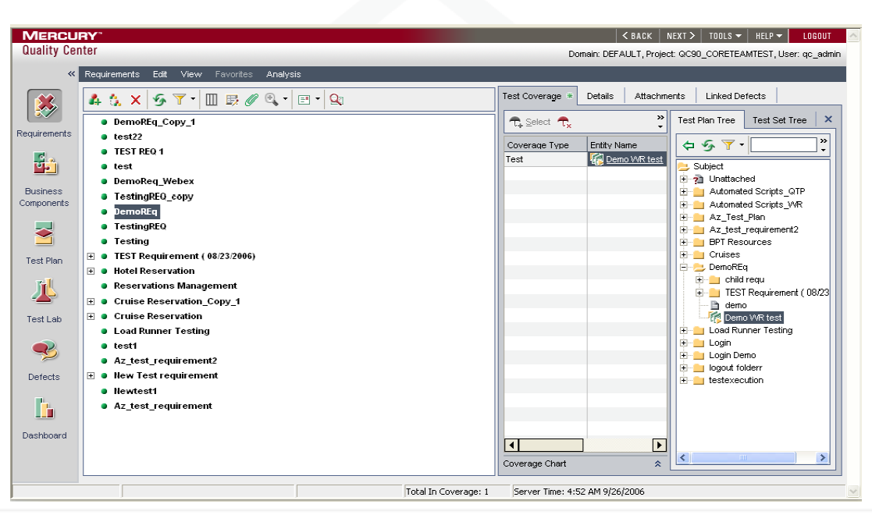
Linking Tests to a Requirement.

Slide 21
Analyzing Test Coverage
Make sure that the Requirements module is displayed.
Display the Requirements tree in coverage analysis view.
Select the Requirement for which you want to view the coverage analysis.
Right click on the requirement and select the coverage analysis option.
Click on the failed area of the graph to view the child requirements with failed status.
Click on show tests coverage link to view the coverage chart.

Slide 22
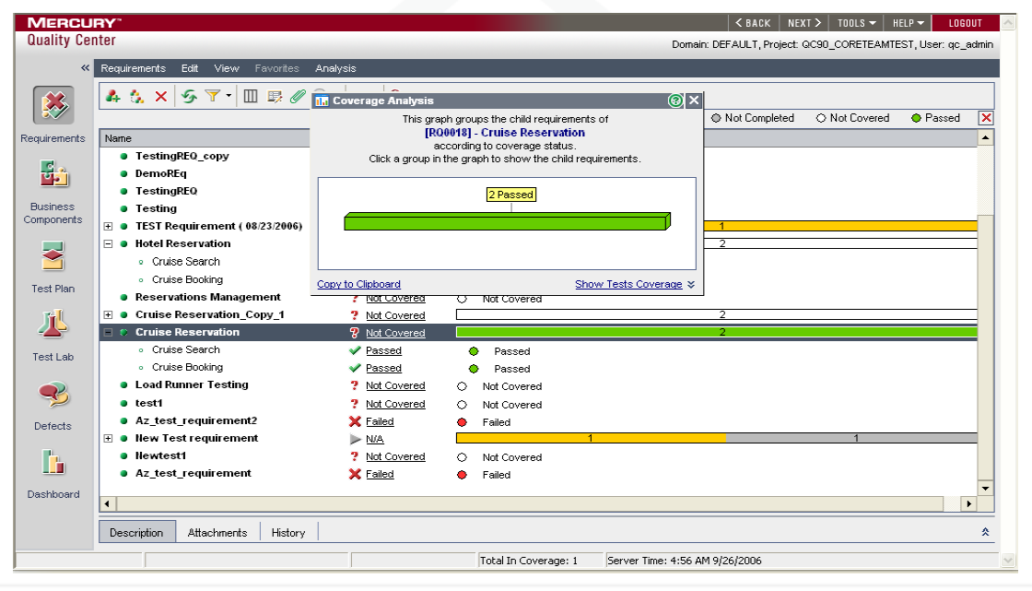
Analyzing Test Coverage

Slide 23
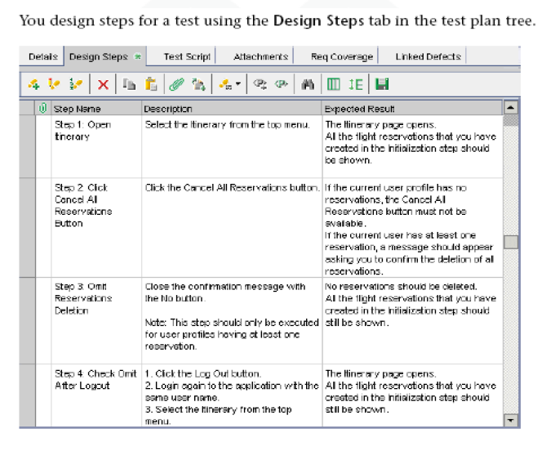
Building Tests

Slide 24
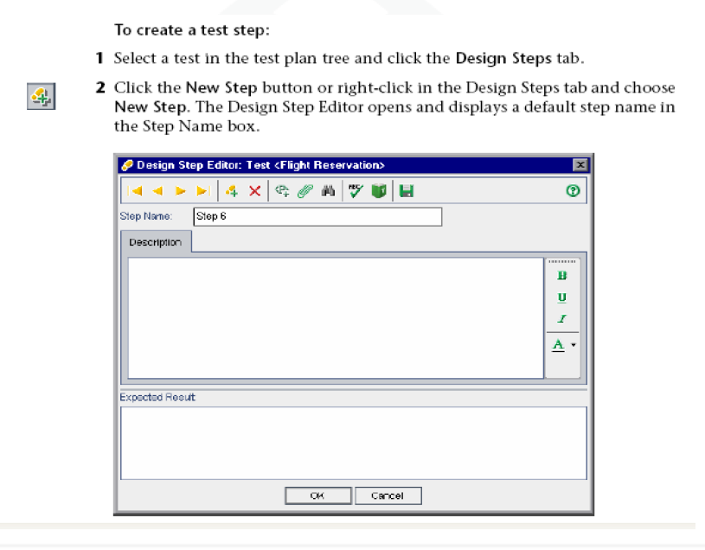
Designing Test Steps

Slide 25
Designing Test Steps
3.Type the Description and expected result.
4.Click New step to add additional steps.
5.Click Ok to close design step editor and add the steps.
6.You can associate an attachment for a test step

Slide 26
Managing Test Steps
User can do the following modifications to test steps.
Edit Test Steps
Reorder Test Steps.
Renumber Test Steps.
Resizing Test Steps.
Arranging Design step columns.
Deleting Steps
Copying Steps
Finding and Replacing Test steps

Slide 27
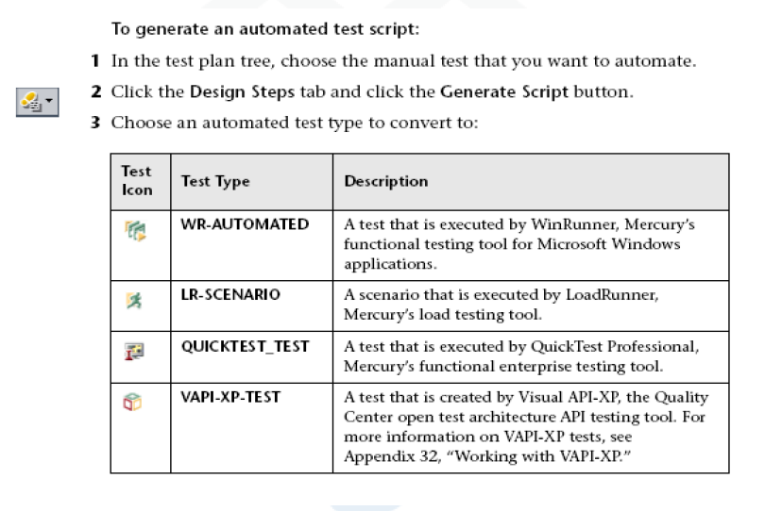
Creating Automated Tests

Slide 28
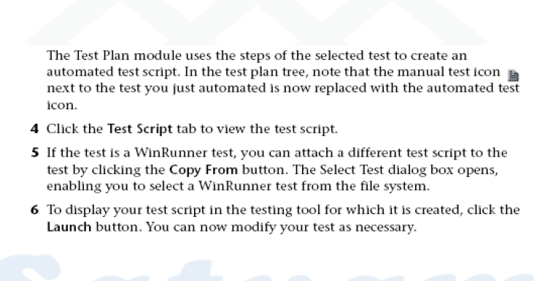
Creating Automated Tests

Slide 29
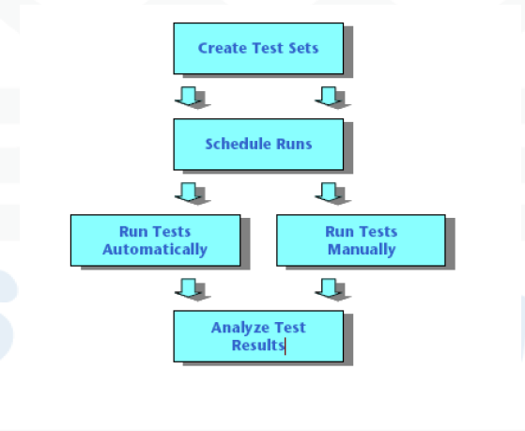
Test Execution (Test Lab Module)
Executing the Test consists of following stages

Slide 30
Creating Test Sets
Start by creating test sets and choosing which tests to include in each test set.
A test set is a group of tests in Quality Center project designed to achieve specific testing goals

Slide 31
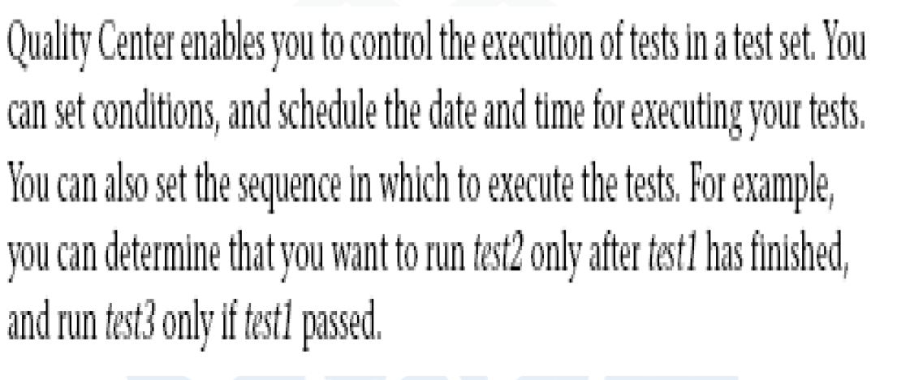
Scheduling Test Runs

Slide 32
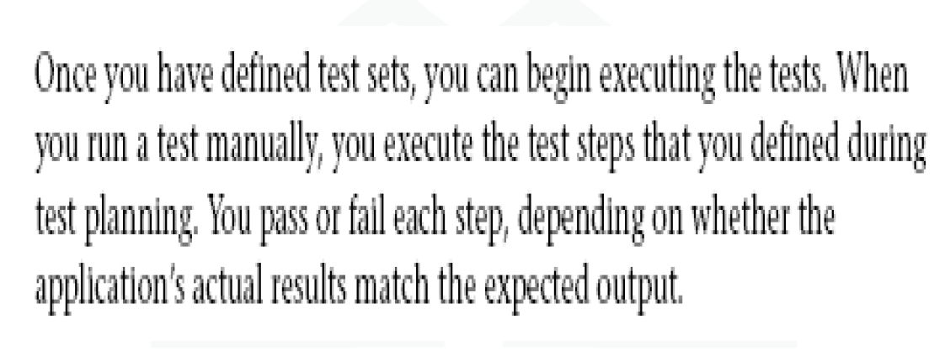
Running Test Manually

Slide 33
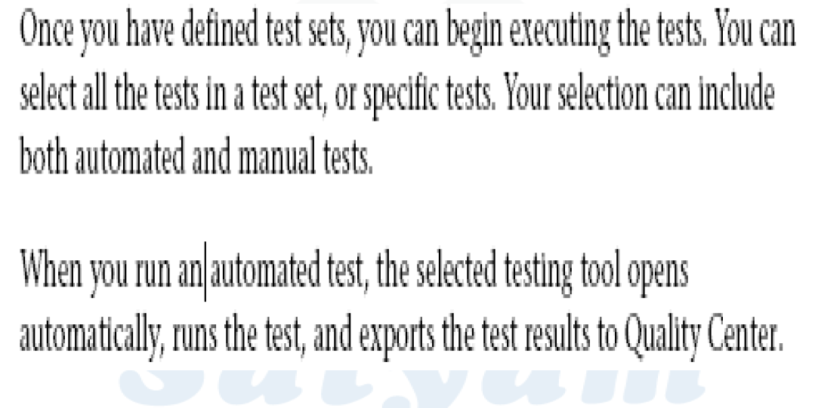
Running Tests Automatically

Slide 34
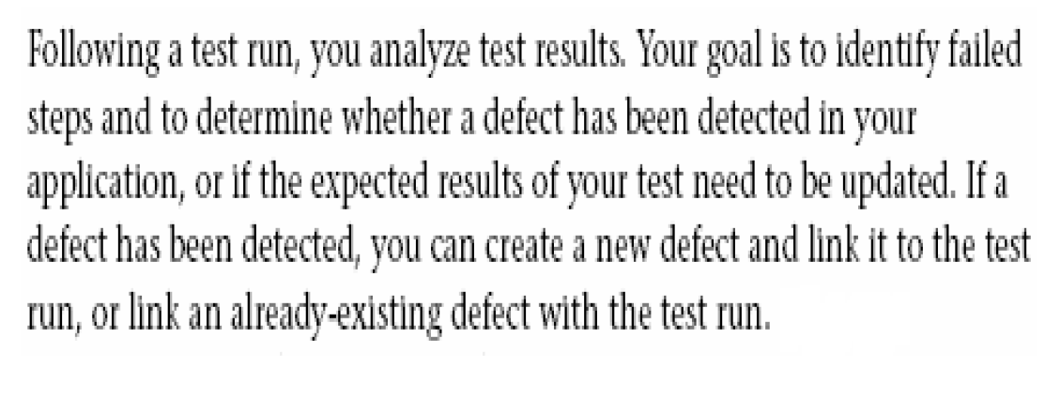
Analyzing Test Results

Slide 35
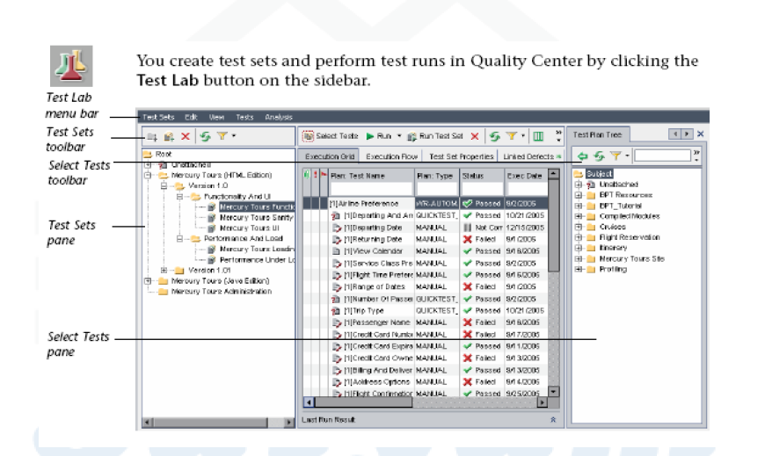
The Test Lab Module

Slide 36
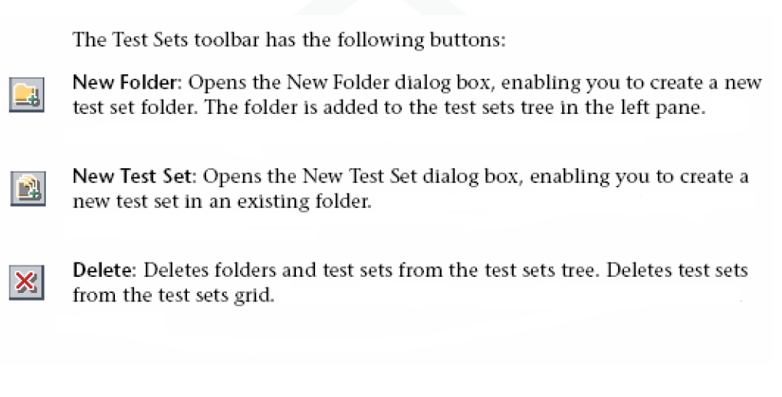
Test Sets Toolbar

Slide 37
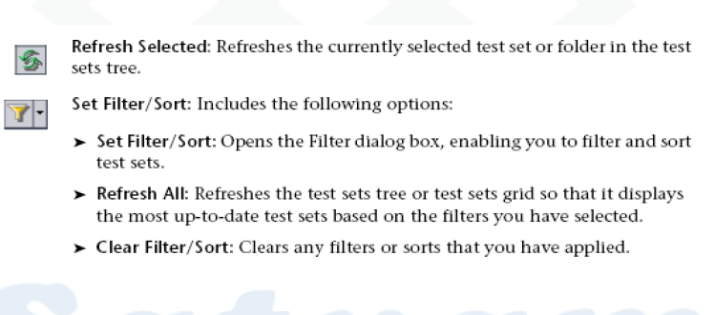
Test Sets Toolbar

Slide 38
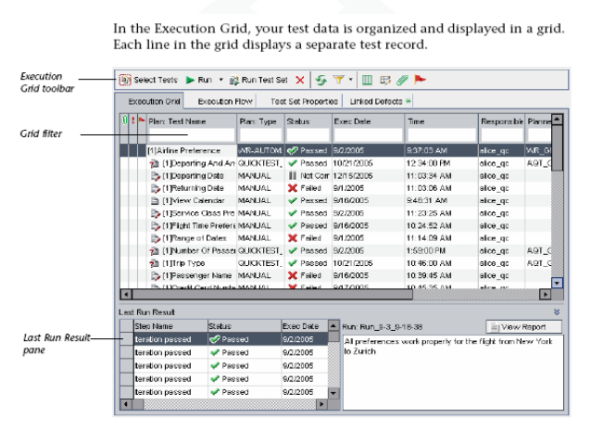
The Execution Grid

Slide 39
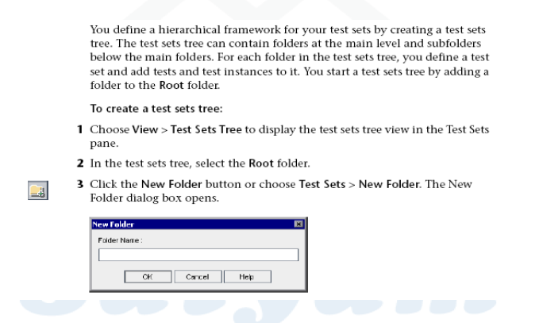
Creating Test Sets Tree

Slide 40
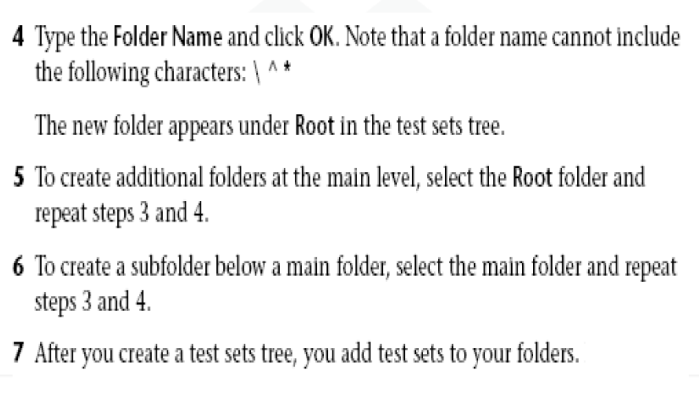
Creating Test Sets Tree

Slide 41
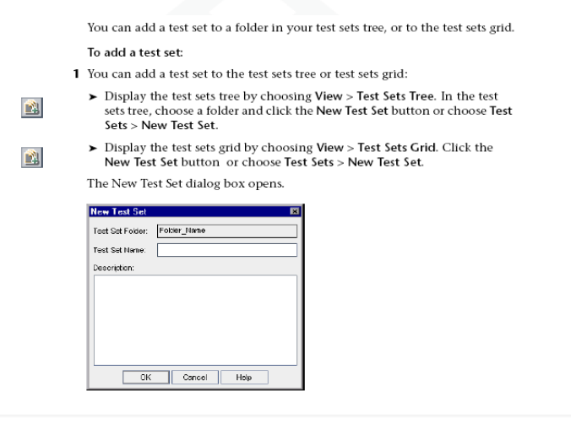
Adding a Test Set

Slide 42
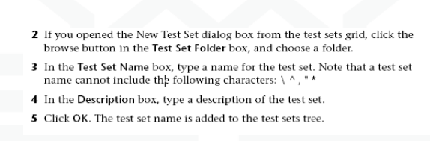
Adding a Test Set

Slide 43
Adding a Test Set

Slide 44
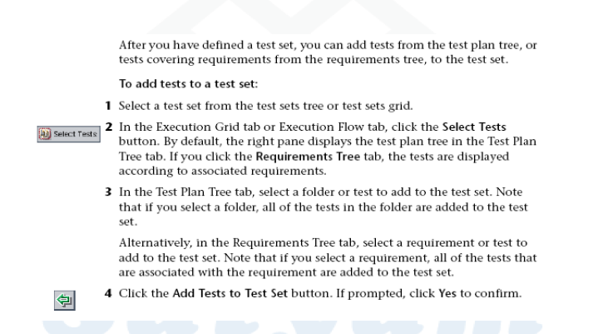
Adding Tests to a Test Set

Slide 45
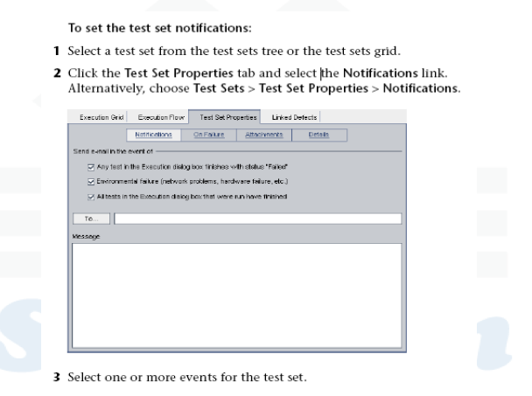
Setting Test Set Notifications

Slide 46
Setting Test Set Notifications
4.To specify who should receive the e-mail, type the e-mail address.
5.In the message box type a message for e-mail.

Slide 47
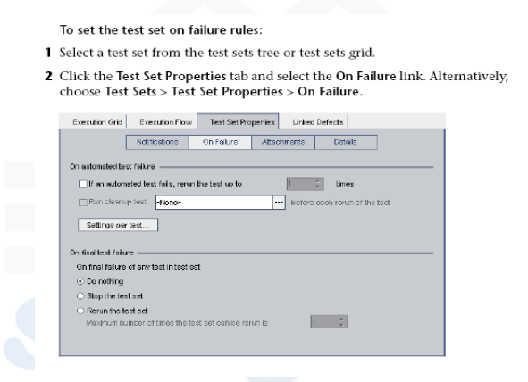
Setting the Test Set on Failure rules

Slide 48
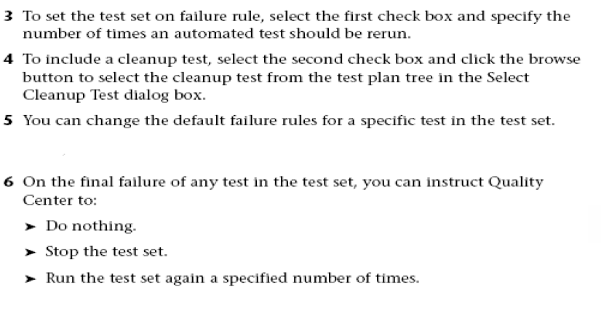
Setting the Test Set on Failure rules

Slide 49
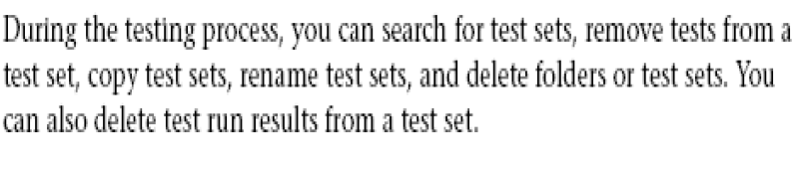
Managing Test Sets

Slide 50
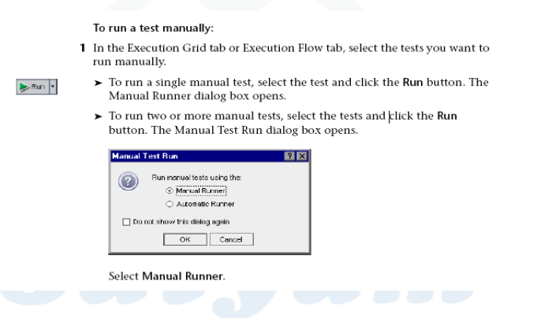
Running Test Manually

Slide 51
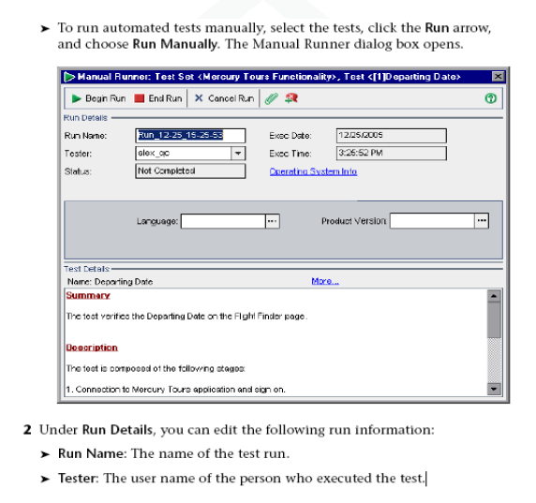
Running Test Manually

Slide 52
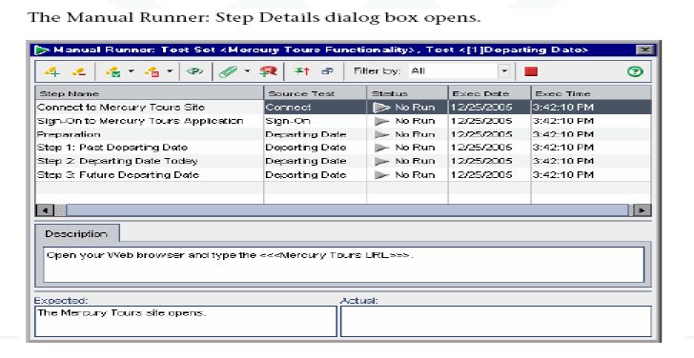
Running Test Manually
3.Click Begin Run button after the settings are made.

Slide 53
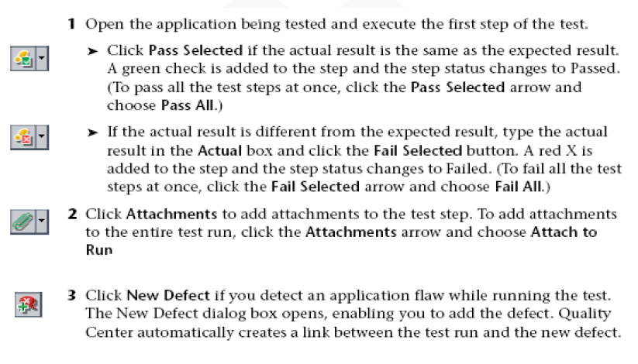
Running Test Manually

Slide 54
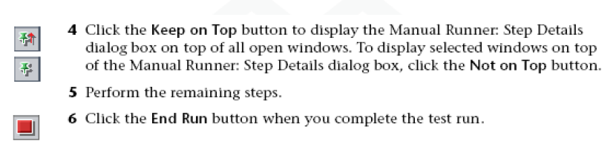
Running Test Manually

Slide 55
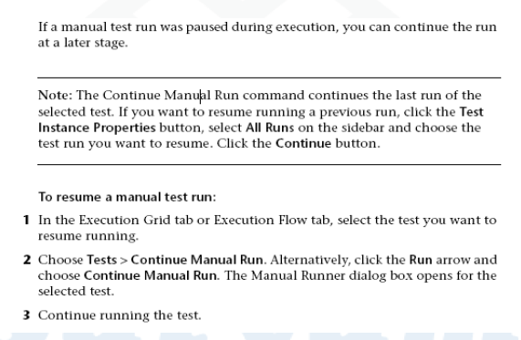
Resuming a Manual Test Run

Slide 56
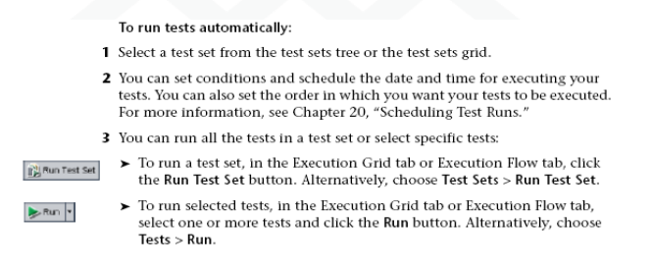
Running Test Automatically

Slide 57
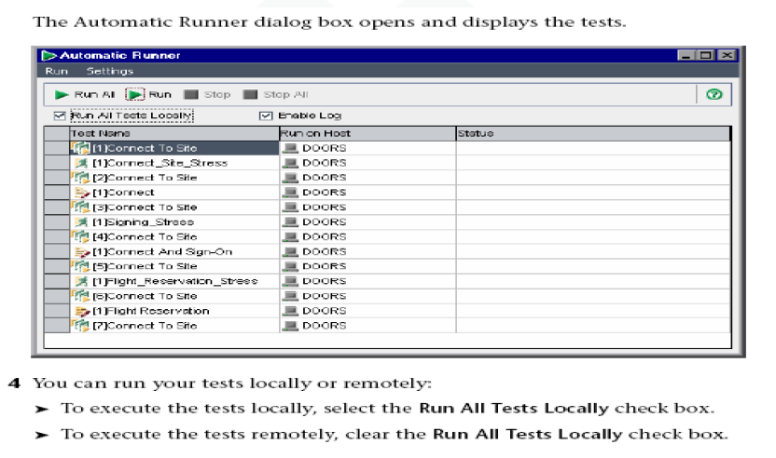
Running Test Automatically

Slide 58
Running Test Automatically
5.To run on remote machine for each test select a host machine.
6.Click Run/Run All .
7.View execution log once the run stops.
8.Exit the automatic runner dialog box

Slide 59
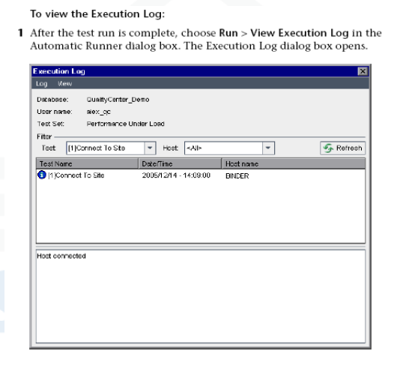
Viewing Execution Log

Slide 60
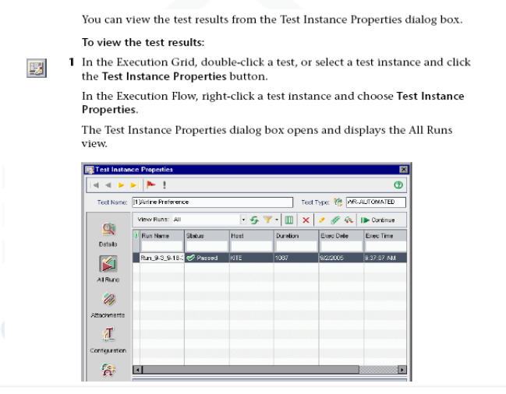
Viewing Test Results

Slide 61
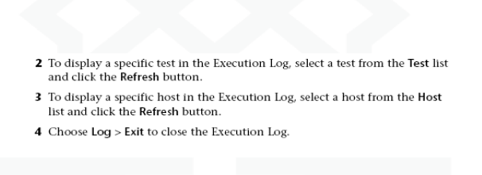
Viewing Execution Log

Slide 62
Thank you

